Slide 1

1/10/2020
Dynamic Network Segmentation for Cyber-Defence
Lewis Sirimongkolkasem
Supervisor: Prof. Emil Lupu

Slide 2
Introduction
Problem Statement, Network Segmentation
Dynamic Network Segmentation for Cyber-Defence

Slide 3

Problem Statement
More sophisticated and hard to detect cyber-attacks
Cyber-defense is expensive
Even security experts have to rely on experience and judgement

Slide 4
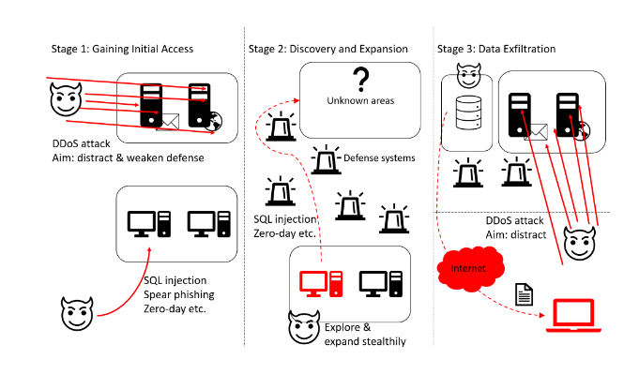
Example of an Advanced Attacker

Slide 5
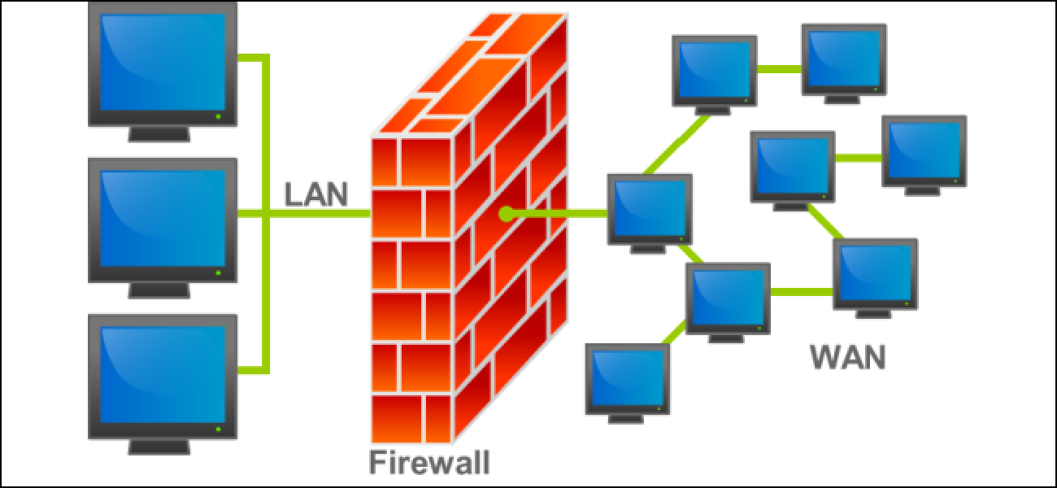
Network Segmentation
Defensive strategy
Split a network into different parts (enclaves), enhance security
https://www.howtogeek.com/144269/htg-explains-what-firewalls-actually-do/

Slide 6
Literature Review
Security Principle, Modelling and Simulation
Dynamic Network Segmentation for Cyber-Defence

Slide 7


Security Principles
2 important principles
Restrict access, slow down attackers
Principle of Least Privilege
Defense in Depth

Slide 8
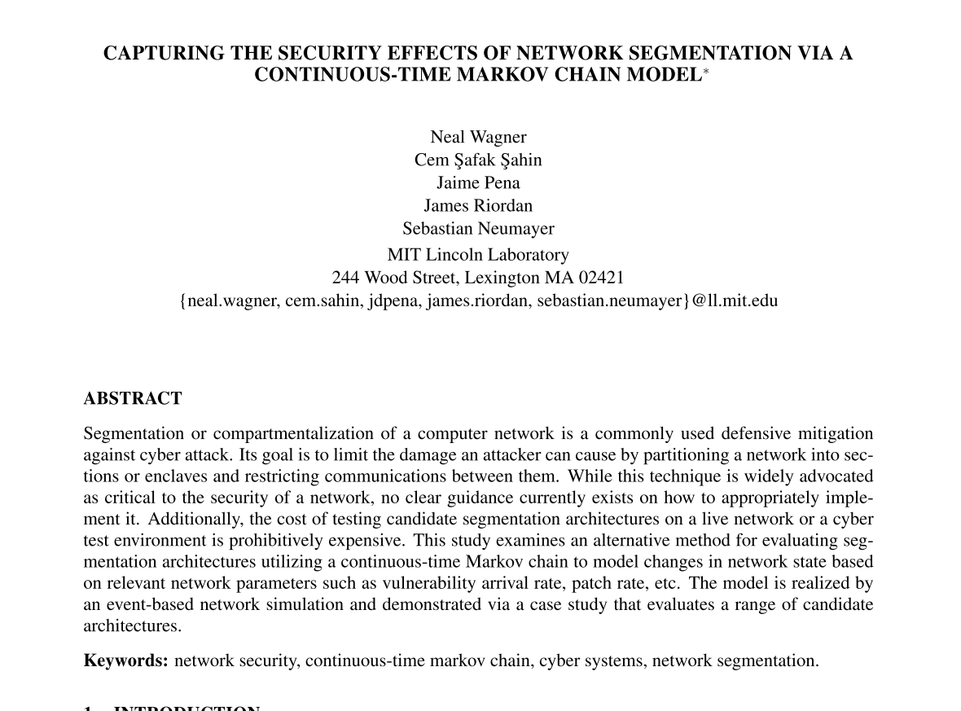
Modelling and Simulation
Utilise Continuous-time Markov chain
Model changes in network state based on Poisson rate
Vulnerability arrival rate, patch rate etc.
Evaluate network segmentation strategies
Principle of least privilege

Slide 9
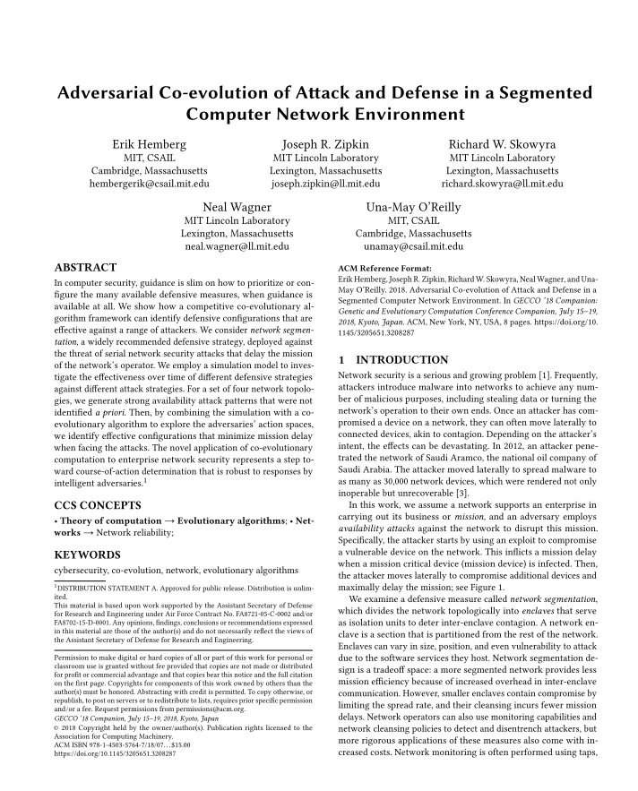
Modelling and Simulation
Coevolutionary algorithm
Evolving attackers and defenders
Attacker uses and evolves availability attacks
Defender changes the network segmentation architecture accordingly

Slide 10
Design
Network Model, Evaluation Metrics, Optimisation
Dynamic Network Segmentation for Cyber-Defence

Slide 11
Network Model
Network Environment
Enclaves
Attack propagation

Slide 12

Network Environment
Enclave: consists of a set of devices interconnected to each other
Functional information flow (FIF)
How attack propagate
Service

Slide 13





Network Environment
Malicious email
1 service, 1 FIF
Internet
Server Enclave
LAN enclave

Slide 14





Network Environment
1
5
3
2
Internet
1
4
Database
LAN enclave
Server Enclave
Admin Enclave

Slide 15
Attack Propagation
Internet
S_{1a} , s_{1b}
s₃
s₄
s₅
e₀
e₁
e₂
e₃
e₄

Slide 16
Service
Probability of successful exploitation of vulnerability
Probability of compromising a destination enclave, given the source enclave is compromised

Slide 17
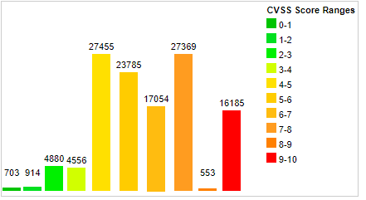
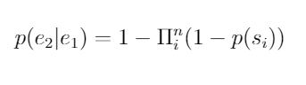
Service
*
Obtain CVSS score from 1 to 10
Divide the score by 10 to obtain probability
(if probability is 1, take away 0.05)
Except internet, p(internet) = 1
Attack propagate from Enclave 1 to Enclave 2
There are n number of services:
s₁ , … s_{n}
e₁
e₂
*https://www.cvedetails.com/

Slide 18
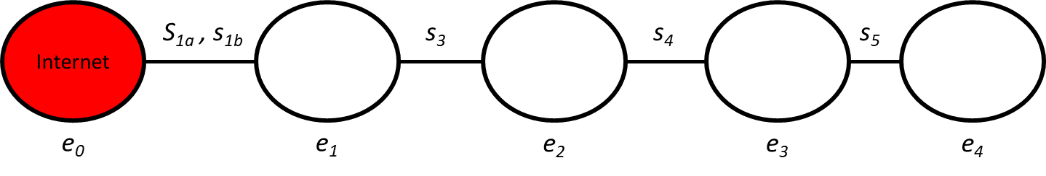
Evaluation Metrics
Marginal probability of compromising an enclave
for example, calculating p(e₄) (not p(e₄|e₃))
Belief propagation
Security score
Cost score
Fitness function

Slide 19
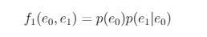
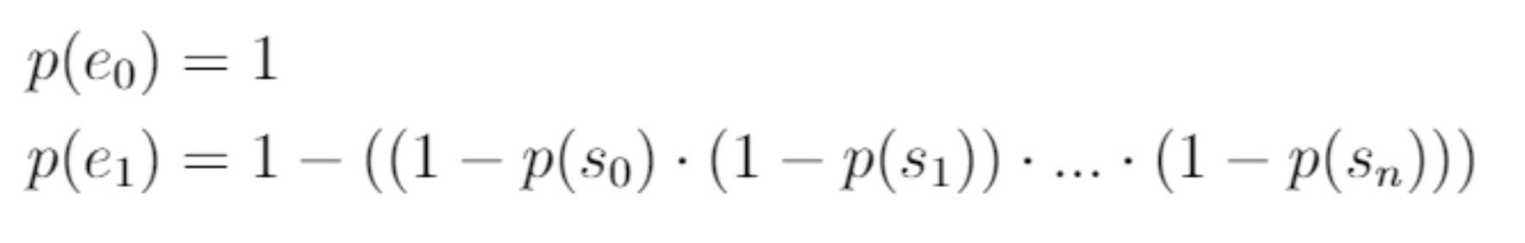
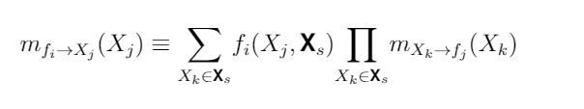
Belief Propagation
Idea of message passing
1
2
Internet
e₀
e₁

Slide 20
Belief Propagation

Slide 21
Belief Propagation
0.15
0.12
0.8
0.1
0.3
0.5
0.1
0.2
0.015
0.1
0.5
0.01
0.5
0.005

Slide 22
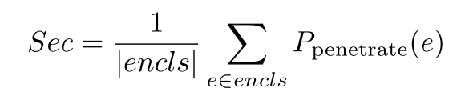
Security Score
How secure the network is
0.15
0.12
0.8
0.1
0.3
0.5
0.1
Sec = 0.1286
0.2
0.015
0.1
0.5
0.01
0.5
0.005

Slide 23
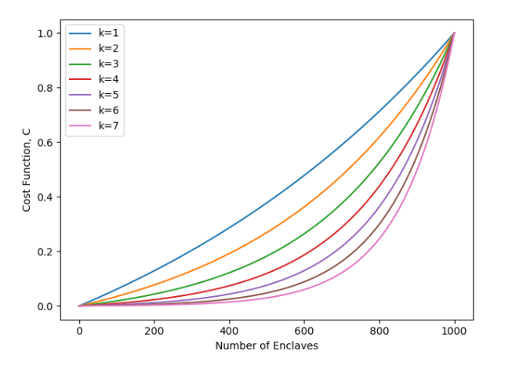
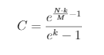
Cost Score
How much to implement this many (N) enclaves
Maximum number of enclaves an organisation can handle (M)
k defines characteristics of cost
(linear, exponential)

Slide 24
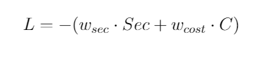
Fitness Function
Overall score for the network architecture
w_{sec} w_{cost} define where the importance is placed, cost or security,
w_{sec} ,w_{cost} [0,1]
w_{sec} + w_{cost} = 1
Balance option
w_{sec} = 0.5
w_{cost} = 0.5

Slide 25

Optimisation
Particle Swarm Optimisation (PSO)
Inspired by bird flocking
One bird = one solution (good or bad)
Exploration relative to other birds’ performance

Slide 26
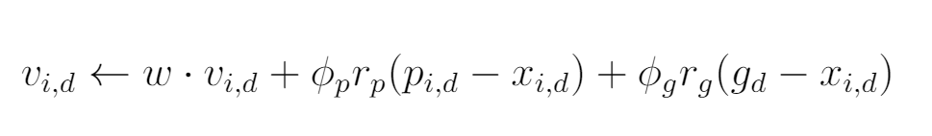
Particle Swarm Optimisation Formula

Slide 27




v_{I} = w · v_{c}
Inertia of current velocity
v_{g} = φ_{g} r_{g}(g - x)
Velocity towards global best position
g
Global best position
v_{c}
current velocity
v = v_{l} + v_{g} + v_{p}
Resultant velocity
r_{p} ,r_{g} ~ U (0,1)
Hyperparameters
w, ɸp, ɸg
Usually between 0.5 -2
v_{p} = φ_{p} r_{p}(p - x)
Velocity towards personal best position
x
Current position
p
Personal best position

Slide 28
v_{I} = w · (+2)
v_{g} = φ_{g} r_{g}(6 - 7)
g
6 Enclaves
v_{c}
current velocity
v = v_{l} + v_{g} + v_{p}
Resultant velocity
v_{p} = φ_{p} r_{p}(5 - 7)
x
7 Enclaves
p
5 Enclaves
N = Number of Enclaves

Slide 29
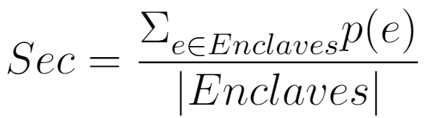
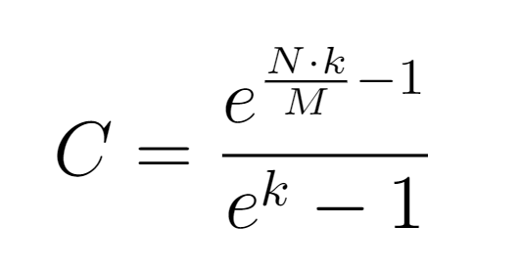
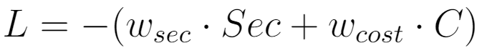
Overview
Traffic Requirements
Number of enclaves
Service Initialisation
Connect enclaves according to traffic requirements
Connect remaining unconnected enclaves
Create a factor graph
Update change in number of enclaves (velocity)
Calculate fitness score
Compute marginal probabilities (Belief Propagation)

Slide 30
Results and Evaluation
Experiments, Results, Hyperparameters
Dynamic Network Segmentation for Cyber-Defence

Slide 31
Experiments
Setup
Internet connects to enclave 1 with service 0 (vulnerability score 0.95)
Enclave 2 connects to enclave 3 with service 1 (vulnerability score 0.95)
Make sure that solutions cannot just be one or a few enclaves with service that has the lowest vulnerability score
Think of enclave 1 and 0 as internet connecting to DMZ
Enclave 1 and enclave 2 are connected by trust relationship

Slide 32
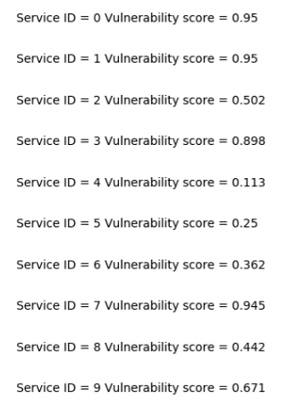
More setup
k = 1
lr = 0.5
w = 0.7
ɸ_{p} = 1.5
ɸ_{g} = 1.5
n = 50
T = 60

Slide 33
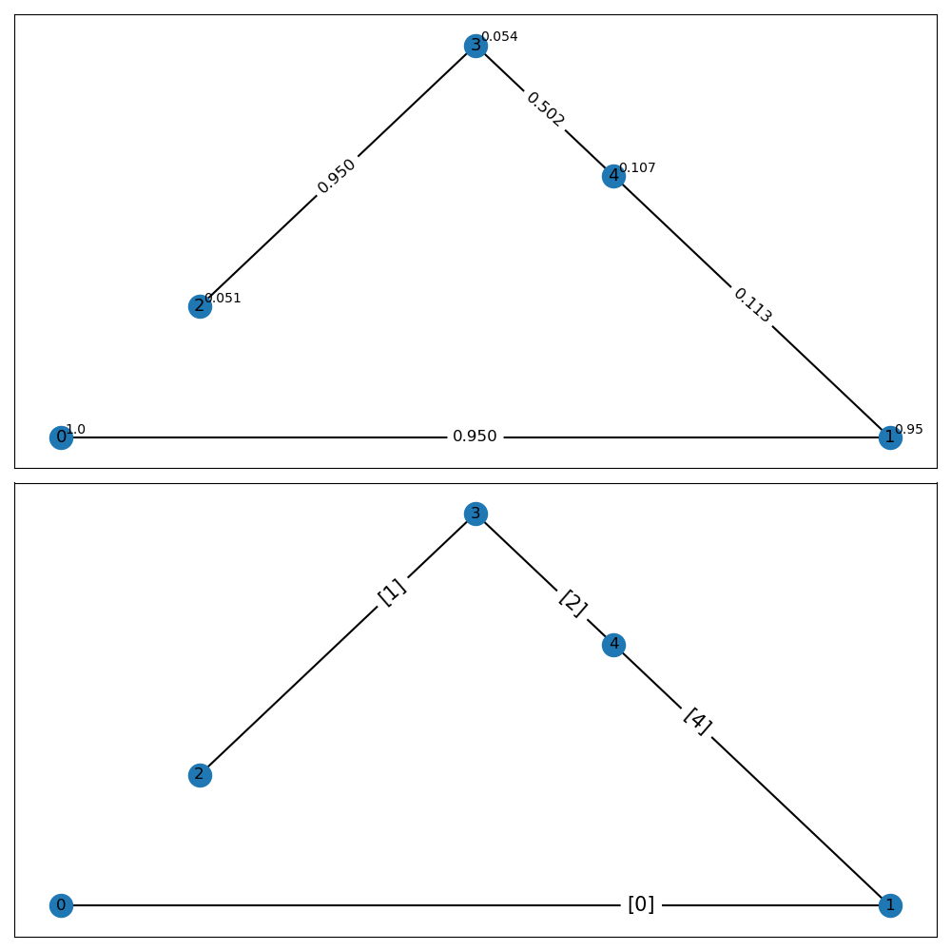
Prioritise Cost
k = 1
lr = 0.5
w = 0.7
ɸ_{p} = 1.5
ɸ_{g} = 1.5
n = 50
T = 60
w_{sec} = 0.2
w_{cost} = 0.8

Slide 34
Prioritise Cost
Almost not implementing any segmentation at all

Slide 35
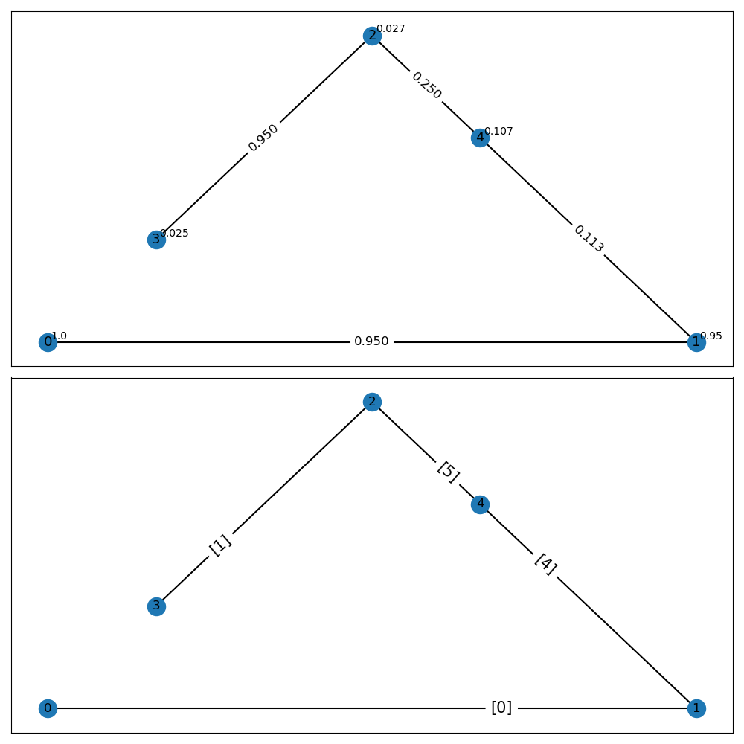
Balance Option
k = 1
lr = 0.5
w = 0.7
ɸ_{p} = 1.5
ɸ_{g} = 1.5
n = 50
T = 60
w_{sec} = 0.5
w_{cost} = 0.5

Slide 36
Balance option
Similar to when prioritising cost
Due to expensive cost function, k = 1

Slide 37
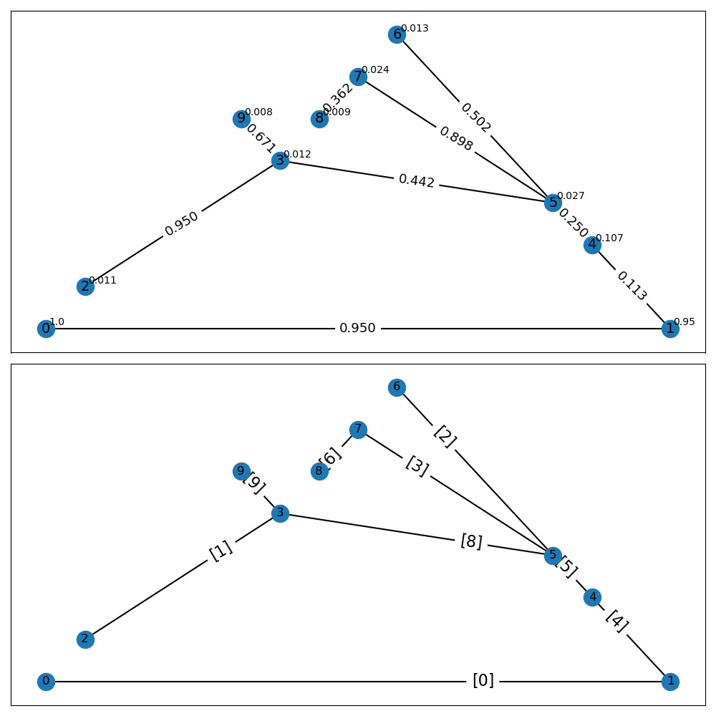
Prioritise Security
k = 1
lr = 0.5
w = 0.7
ɸ_{p} = 1.5
ɸ_{g} = 1.5
n = 50
T = 60
w_{sec} = 0.8
w_{cost} = 0.2

Slide 38
Prioritise Security
More enclaves implemented, but still does not implement all
Only 9 out of 30
Quality vs quantity

Slide 39
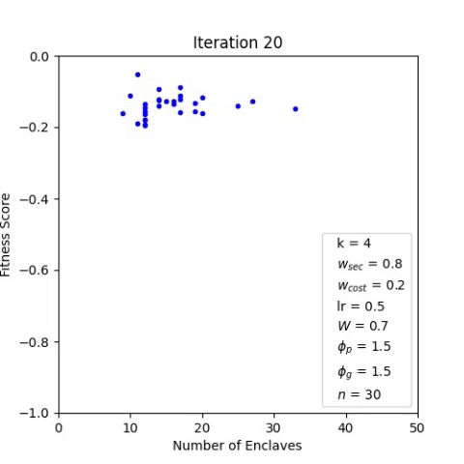
Hyperparameters

Slide 40
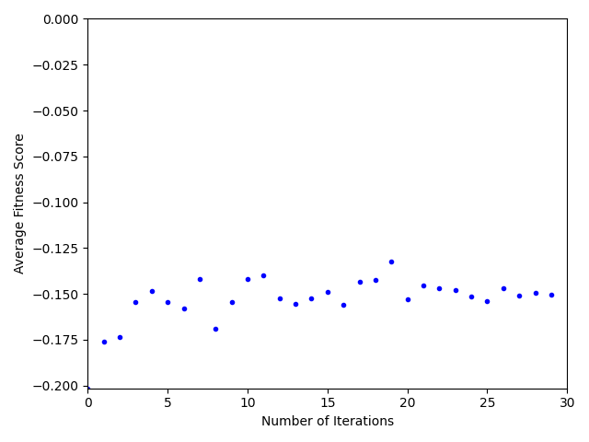
Hyperparameters

Slide 41
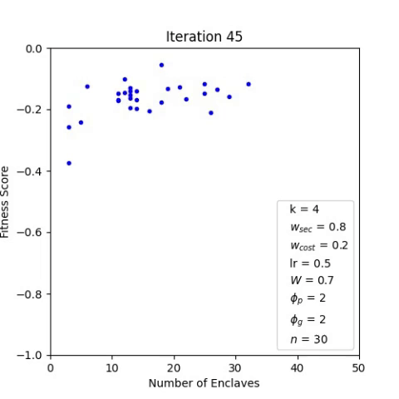
High ɸp, ɸg
Particles do not clump together

Slide 42
Demo

Slide 43
Conclusion
Contributions, Limitations, Summary
Dynamic Network Segmentation for Cyber-Defence

Slide 44
Contributions
Identified modern cyber-risks and difficulty of defending these attacks
Reviewed current state of art on network segmentation
Modified Wagner et al. model with probabilistic approach
Proposed a different optimisation algorithm

Slide 45
Contributions
Investigated the trade-off between cost and security when applying network segmentation
Investigated how hyperparmeters affect particle swarm optimisation performance

Slide 46
Limitations
Limited scope
Only consider tree network structure
Metrics too simple
Most optimal solution should always be a chain structure
Limited device level impact
Enclaves does not contain information about devices within it

Slide 47
Limitations
Scalability
Worst case computational complexity O(nTM²)
Redundancy
In PSO, particles may collide (visit already explored solution)

Slide 48
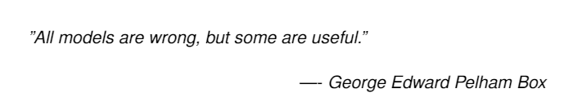
Summary
Network segmentation is important
Cannot blindly implement
Need proper implementation and balance between security, cost and also other factors (which we did not model)

Slide 49
Future Work
Device-level Modelling, Evaluation Metrics
Hyperparameters Tuning
Dynamic Network Segmentation for Cyber-Defence

Slide 50
Device-level Modelling and Grouping
Enclave currently does not contain information about devices within
E.g. database, web server, admin computer
Grouping strategies to form enclave

Slide 51

Better Evaluation Metrics
Include importance of enclave
Admin enclave > public facing servers
>

Slide 52
Automatic Hyperparameters Tuning
How to find the best w, ɸp, ɸg ?

Slide 53
Thank you

